Slide 1
BIKE SHARE STUDY

Slide 2
OBJECTIVE
Improve marketing strategies.
Convert annual members to casual members

Slide 3
Resources
Use the data for the last 12 months for the analysis process

Slide 4
Past 12 months overview
casual 2365120 members
annual 3463964 members
Average ride duration:
Casual:35827.37 secs
Annual:17553.67secs

Slide 5
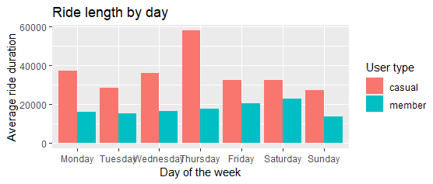
RIDE LENGTH BY DAY

Slide 6
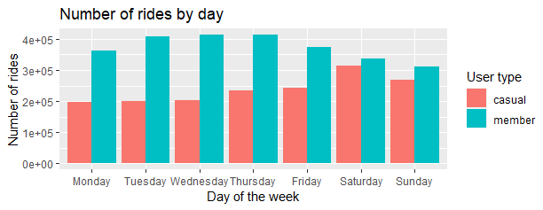
NUMBER OF RIDES PER DAY

Slide 7
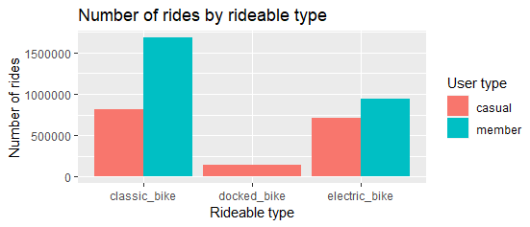
Number of rides by rideable type

Slide 8
ANALYSIS SUMMARY
Casual riders prefer either:
Electric bikes
Classic bikes
Enjoy summer rides
Ride longer in average
Ride more frequent and longer and weekends

Slide 9
RECOMMENDATION
Increase numbers of electric bikes
Summer promotion for membership fee
Introduce more membership points for weekends that can be redeemed for a certain package.

